Slide 1

AWS API Gateway
Efficient API Management on AWS

Slide 2

Introduction
AWS API Gateway is a fully managed service that makes it easy to create, publish, maintain, monitor, and secure APIs at any scale. It enables developers to build robust, scalable APIs that connect applications, data, and devices globally.

Slide 3

01
AWS API Gateway Overview

Slide 4

Features and Capabilities
AWS API Gateway supports RESTful and WebSocket APIs, automatic scaling, traffic management, authorization, and access control. It integrates seamlessly with AWS Lambda, facilitating serverless application architecture and reducing backend complexity.

Slide 5
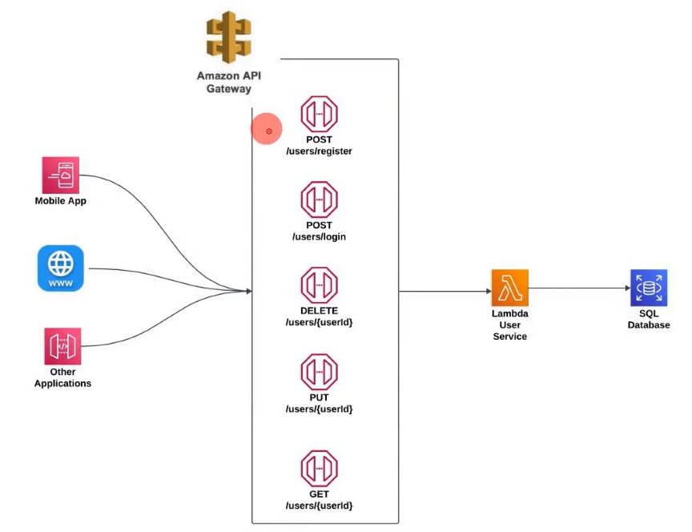
Use Cases in Modern Architectures
It is widely used for building microservices, connecting front-end applications securely to backend resources, enabling real-time two-way communication with WebSocket APIs, and supporting mobile and IoT applications.

Slide 6
Integration with AWS Ecosystem
AWS API Gateway integrates deeply with AWS Lambda, IAM, CloudWatch, and other AWS services. This enables seamless automation, secure access control, detailed monitoring, and simplified backend management to support scalable and resilient applications.

Slide 7

02
API Gateway Management and Security

Slide 8
Deployment and Versioning Strategies
API Gateway supports staged deployments and versioning, allowing controlled release cycles and rollback capabilities. This facilitates safe updates and continuous delivery in dynamic production environments.

Slide 9

Security Features and Access Control
It offers multiple security options, including AWS IAM policies, custom authorizers, and Amazon Cognito integration for user authentication. These ensure robust API access management and data protection.

Slide 10
Monitoring, Logging, and Performance Optimization
With integration into Amazon CloudWatch, API Gateway provides detailed metrics and logs for monitoring API usage and performance. This aids in proactive troubleshooting and optimizing response times.

Slide 11
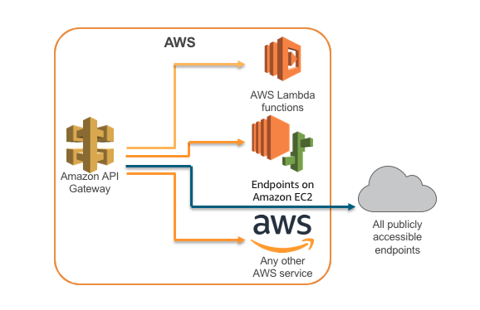
Conclusions
AWS API Gateway delivers a powerful, secure, and scalable platform for API management. Its tight integration with AWS services streamlines development and operations, making it essential for modern cloud-native architectures.

